Slide 1

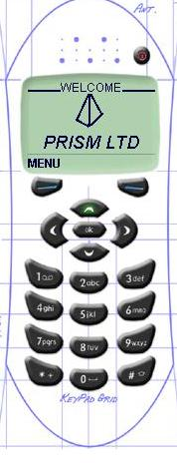
WAP BASED MAIL SERVER
PROJECT GROUP
TEJASWITA PANVALKAR (17)
SMITA DHENDE (03)
PUJA SAHAY (28)
NILIMA JAID (06)
PROJECT GUIDE
SONALI IDETA

Slide 2
PROJECT DESCRIPTION
E-mail and WAP are fast becoming the most demanded combinations of technology by business man and general consumer.
WAP devices will mainly include two features :
1) Integrated browsers called micro browsers.
2) A mechanism for user input which can range from couple of buttons on simple models to entire bank of buttons with roll bar and touch screens on higher end modules.

Slide 3
This will provide personal communication technology : Delivering the convenience of portability from mobile phones while list allowing instant access to e-mail providing asynchronous access to written messages.
Mail server help user to send SMS to other mobile devices and connect to other POP3 mail servers like mail.yahoo.com or hotmail.com.

Slide 4
SCOPE OF PROJECT
The user can create account by providing Email address & can send mail using those address.
Mails can be composed off line. Connection is made only during the transfer of the mail.
For receiving mail the email addresses provided and the specified server is contacted. All the mails on the server are downloaded and connection is released.

Slide 5
The user can composed, send an reply to mail via. SMTP server.
User can view and read mail using a POP3 service, and can determine the number of messages waiting in the inbox.
User can delete the mails and log out from mail box and can easily view the attachments.
Once the mails are downloaded user can read them off line.

Slide 6
WIRELESS APPLICATION PROTOCOL
WAP based mail server is going to be developed in WAP (Wireless Application Protocol). WAP is Today’s business world requirement.
What is WAP?
The Wireless application protocol is a communication protocol & application environment for the development of information resources, advanced telephony services & information access from mobile devices

Slide 7
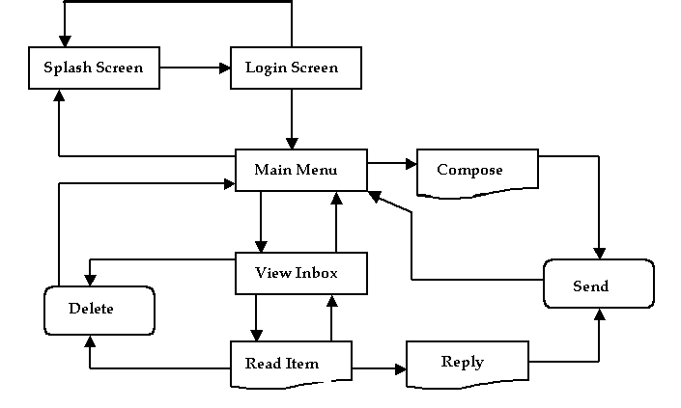
WORKING OF MAIL SERVER

Slide 8
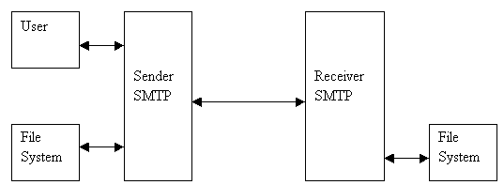
WORKING OF SMTP PROTOCOL
SIMPLE MAIL TRANSFER PROTOCOL
Sender SMTP
Receiver SMTP

Slide 9
WORKING OF POP3 PROTOCOL
POP3 mail server (version 3) is a standard for storing email on a mail server until mail client can retrieve it.
POP3 mail server mainly used for accessing all the messages regardless of the operating system of the client e.g. includes Microsoft Outlook for PC and Qualcomm Eudora for Mac.

Slide 10
LIMATION OF WAP SERVER
It has minimal error checking.
There is no guarantee that a WML deck of more than 1400 bytes will be accepted by the WAP browser. Large emails or a long list of emails in the inbox will cause problems.
It is not implemented for maximum speed and efficiency
It can only be used by a single user - session information is held in a static class variable.
It has some problems if the browser does not correctly respond to Cache-Control response headers.

